Slide 1
Title of the presentation
Mini-Symposium : MS-02
Author 1, Author 2, Author 3
University of Calabria
University of Salerno
LOGOS
LOGOS
LOGOS
LOGOS
LOGOS

Slide 2
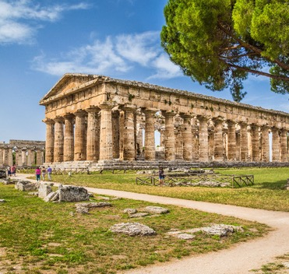
The city of Paestum
Paestum, a historic city located in the province of Salerno, Campania, is one of the archaeological gems of southern Italy. An ancient Greek colony founded under the name of Poseidonia, Paestum is now a fascinating destination that blends the elegance of classical history with the tranquility of the Mediterranean rural landscape.
Famous for its majestic Doric temples, among the best-preserved in the world, Paestum is a place where history, art, and nature come together in an extraordinary way. Its Archaeological Park, a UNESCO World Heritage site, tells millennia of civilization through monuments, ancient streets, and a museum filled with remarkable artifacts.
Situated between the Tyrrhenian Sea and the hills of Cilento, Paestum is also renowned for its authentic, relaxed atmosphere, making it an ideal destination for those seeking culture, beauty, and tradition.

Slide 3
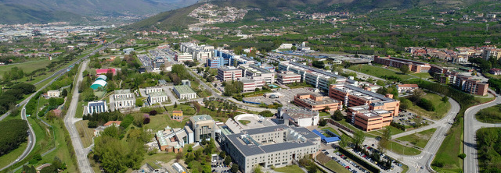
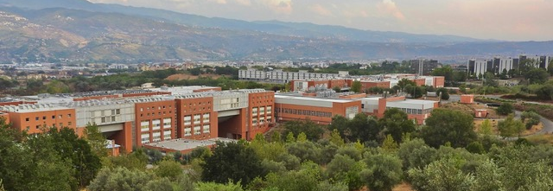
Organizing institutions
The ESAFORM 2025 conference is proudly organized by two prominent Italian institutions the University of Calabria and the University of Salerno.
The University of Salerno, boasts a rich academic tradition and a strong emphasis on technological advancement and industrial collaboration. Together, these universities bring a wealth of expertise and a shared dedication to advancing the field of materials forming.
University of Calabria, located in Rende, is renowned for its commitment to research and innovation, particularly in engineering and materials science. Its modern campus and interdisciplinary approach foster a dynamic academic environment.

Slide 4
Questions ?
We have one laptop on each presentation room, Videos are allowed.
Please contact the organization committee, if you need help.
See you in Paestum soon !

